Slide 1
Software Quality Engineering
Lecture 3-software testing
QUALITY engineering TOOLS
Alina Arshad
alina.arshad@nu.edu.pk

Slide 2
Verification & Validation

Slide 3
Verification and Validation
Verification:
Are we building the product right?
Software must conform to its specification
Internal viewpoint
Validation:
Are we building the right product?
Software should do what the user really requires
External viewpoint
(Boehm, 1979)

Slide 4


V&V understanding by real life e.g.
Verification
Validation
Know the recipe
Have all ingredients
Taste before serving

Slide 5
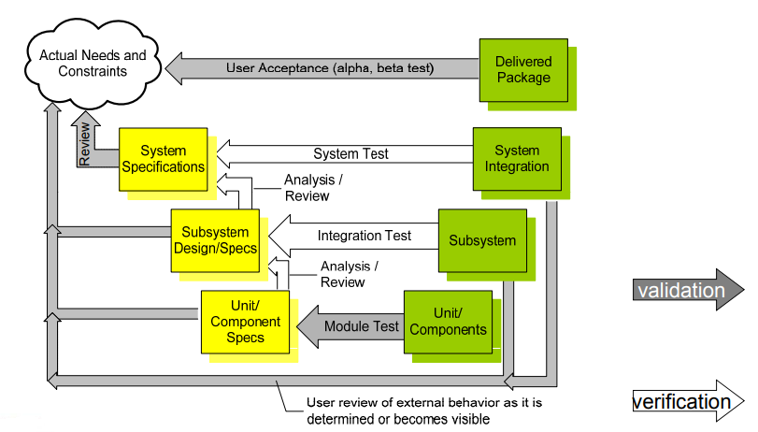
Validation and Verification Activities

Slide 6
Objectives of V&V
Two principal objectives:
Discovery of defects in a system
Assessment of whether the system is usable in an operational situation
V & V must be applied at each stage in the software process to be effective.

Slide 7
Approaches to V&V
Software inspections / peer reviews:
Analysis of software documents and source code
Static process, doesn’t need to run the system
May be supplemented by tool-based analysis of documents and program code
Software testing:
Running an implementation of the software with test data
Dynamic process, main V&V technique

Slide 8

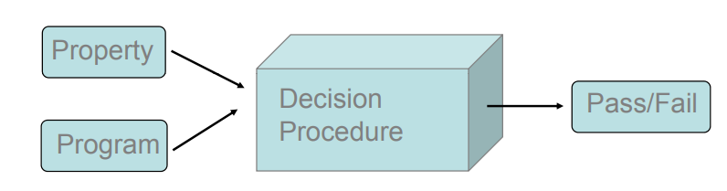
Correctness properties are undecidable
the halting problem can be embedded in almost every property of interest

Slide 9
Variety of approaches for testing
There are no fixed recipes
Test designers must
choose and schedule the right blend of techniques to reach the required level of quality
Design a specific solution that suits the problem, the requirements

Slide 10
Testing & Debugging
These are two distinct processes.
Verification and validation is concerned with establishing the existence of defects in a program.
Debugging is concerned with locating and repairing these defects.
Debugging involves formulating a hypothesis about program behavior and then testing this hypothesis to find the error.

Slide 11
What about faults?
Three approaches to reducing the number of faults in computer systems:
Avoidance
Detection & removal
Tolerance

Slide 12
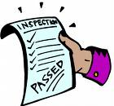
What is an Inspection?
Inspection in software engineering, refers to peer review of any work product by trained individuals who look for defects using a well-defined process. An inspection might also be referred to as a Fagan inspection after Michael Fagan, the inventor of the process.

Slide 13
Inspection Purposes
Primary Purpose
Identify potential defects during preparation and validate them at the meeting.
Validate the fact that identified items are actual defects.
Record the existence of the defect.
Provide the record to the developer to use in making fixes.

Slide 14
Inspection Purposes
Secondary Purpose
To increase programming quality
To achieve lower life cycle cost
To provide traceability of requirements to design
To increase product quality at delivery etc.

Slide 15
Inspection Team Members
During an inspection the following roles are used:
Author: The person who created the work product being inspected.
Moderator: This is the leader of the inspection. The moderator plans the inspection and coordinates it.
Reader: The person reading through the documents, one item at a time. The other inspectors then point out defects.
Recorder/Scribe: The person that documents the defects that are found during the inspection.
Inspector: The person that examines the work product to identify possible defects.

Slide 16
Inspection Process (Cont..)
The stages in the inspections process are:
Planning
Overview meeting
Preparation
Inspection meeting
Rework and
Follow-up
The Preparation, Inspection meeting and Rework stages might be iterated.

Slide 17
Formal Technical Reviews (FTR)
FTR is one of the techniques for improving software quality.
The FTR is a software quality assurance activity with the objectives to uncover errors in function, logic or implementation for any representation of the software.
FTR (Formal Technical Review) is also a learning ground for junior developers to know more about different approaches to software analysis, design and implementation.

Slide 18
Formal Technical Reviews (Cont..)
FTR activities include walkthroughs and inspections.
Formal technical review methods began in 1976 with the publication of Fagan's code inspection techniques.
Reviews are the most widely used approach for assessing software quality.

Slide 19
Five basic questions
When do verification and validation start?
What particular techniques should be applied during development?
How can we assess the readiness of a product?
How can we control the quality of successive releases?
How can the development process itself be improved?

Slide 20
When do verification and validation start?
Test is not a (late) phase of software development
V&V start as soon as we decide to build a software product, or even before
V&V last far beyond the product delivery as long as the software is in use
The feasibility study of a new project must take into account the required qualities and their impact on the overall cost
At this stage, quality related activities include
risk analysis
measures needed to assess and control quality at each stage of development.

Slide 21
Any question????

